Slide 1
Introduction to Palliative Care
Jigar Joshi MBBS
Hospice and Palliative Medicine Fellow

Slide 2
Objective
Define and understand Palliative Care philosophy and approach
Training path for Hospice & Palliative Medicine
Need and future of Palliative Medicine
Open Discussion

Slide 3
About Me
Medical Graduate from Mumbai, India (2007)
Palliative physician in Mumbai, India (2 ½ yrs)
IM Residency at Mt Sinai Hospital, Chicago, IL (2011-2014)
Fellowship in Hospice and Palliative Medicine (Current)

Slide 4
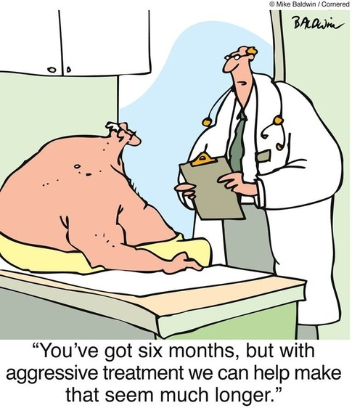

Slide 5
Learning from a Case
65 Y/ F with Multiple myeloma (a Cancer with spread to bones) since >7 years
>18-20 fractures
Multiple pressure wounds on the skin
4 ICU admissions in last 1 year
Concerns:
  Pain
  Emotional / Social
  Spiritual

Slide 6
Facts
USA (2010)
  Life expectancy: ~79 years
  Deaths: 2,515,458
  Place of death:
    ~ ½ in Acute care setup
    ~ 17-20% in ICU
    ~ 1/5 in Nursing home
    ~ ¼ at home
Global
  4/1000 people need Palliative Care at EOL
} 2/3 in hospital !!!

Slide 7
Palliative Medicine
What is it?
WHO:
An approach to improve the quality of life of patients and their families facing the problem associated with life-threatening illness, through the prevention and relief of suffering by means of early identification and impeccable assessment and treatment of pain and other physical, psychosocial and spiritual problems

Slide 8
Palliative care for Children
Active total care of the child's body, mind and spirit, and giving support to the family
it can be successfully implemented even if resources are limited
*The principles apply to other pediatric chronic disorders (WHO; 1998a)

Slide 9
What do we do?
relief from pain and other distressing symptoms
affirm life and regard dying as a normal process
neither hasten nor postpone death
integrate the psychological and spiritual aspects
Help patients live as actively as possible while dealing with a serious illness
Help the family cope during the patient’s illness and in their own bereavement

Slide 10
What do we do?
A team approach to address the needs of patients and their families
Enhance quality of life and may also positively influence the course of illness
Applicable early in the course of illness, in conjunction with other life prolonging therapies
Investigate when needed to better understand and manage distressing symptoms

Slide 11
Who can get ?
Pathology (terminal/complex)
  Malignancy (cancer)
  Non-cancer diagnosis: (2/3rd)
    End stage diseases of heart, lung, kidney, nervous system, digestive system, connective tissue etc.
    Dementia and behavioral disorders
    HIV / AIDS or any other severe infections
Clinical
  Worsening functional status (Quality of life)
  Multiple hospital admissions

Slide 12
Why Palliative Medicine?
Every one deserves Death with Dignity
Rising number of people suffering from terminal illnesses /Complex disease process
Specialized multidisciplinary team required
Timely H&PC can improve survival
Care for family after death
Saves cost of care ($5,282 / admission)
Reduces ER visits at end of life

Slide 13
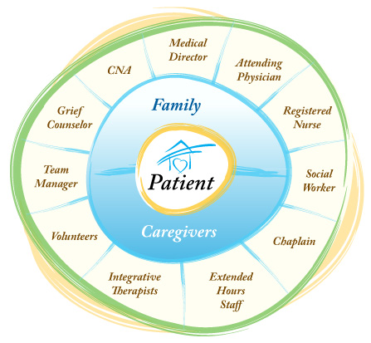
Who are part of the team

Slide 14
Where?
HOME
OUT PATIENT (AMBULATORY)
Inpatient
Continuous care
Respite care
Bereavement (for family)

Slide 15
Palliative care transition
Diagnosis
Death
Life Prolonging Management
HOSPICE
<6 mths
Palliative Management
Bereavement
DESIRED
Life Prolonging Management
HOSPICE
<6 mths
Palliative Management Bereavement
REALITY

Slide 16
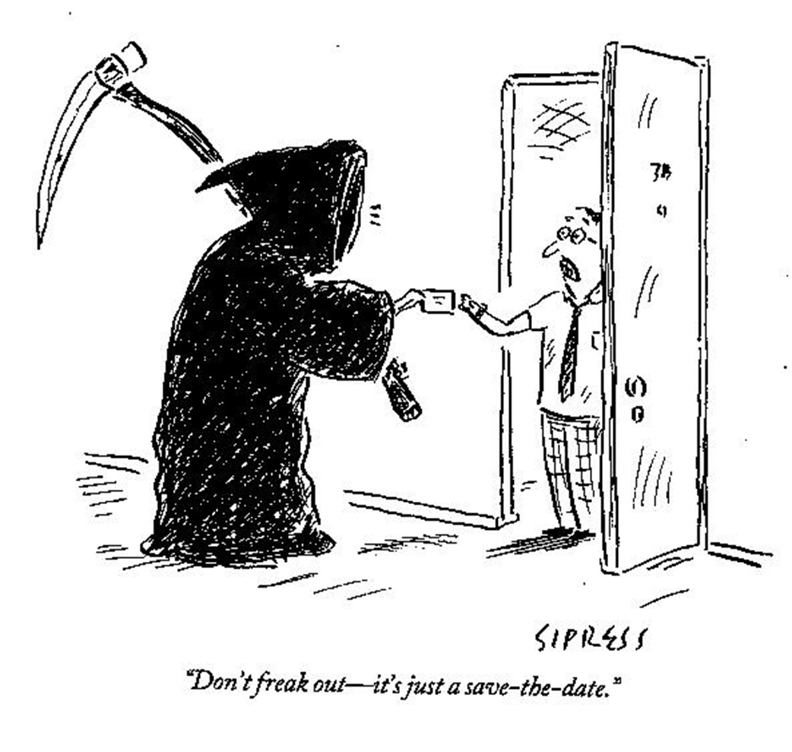
Don’t be too late!

Slide 17
Training in HPM
Conference/seminar/workshop
    Regional
    National (AAHPM)
    International
Clinical rotation with H&PM team
    Student
    Resident
    Fellow in other sub-specialty
EPERC (fast facts from MCOW)
    http://www.eperc.mcw.edu/EPERC/FastFactsandConcepts

Slide 18
Training in HPM
Fellowship in Palliative Medicine
  Minimum 1 year duration
  2 year research pathway also possible
  Clinical specialties
Board Certification in Palliative Medicine
  Must have 1 year fellowship

Slide 19
Future of Palliative Medicine
Moving upstream with early consult at the time of diagnosis
Increase availability of Ambulatory Palliative care
Need: 18,000 fellowship trained H&PC physicians
~70% of health care in USA have PC program

Slide 20
Summary
Palliative medicine can see and help at all stages illness
Palliative Medicine is a rapidly growing subspecialty and a great career choice
Death is a normal part of life and every one deserves death with dignity and comfort

Slide 21
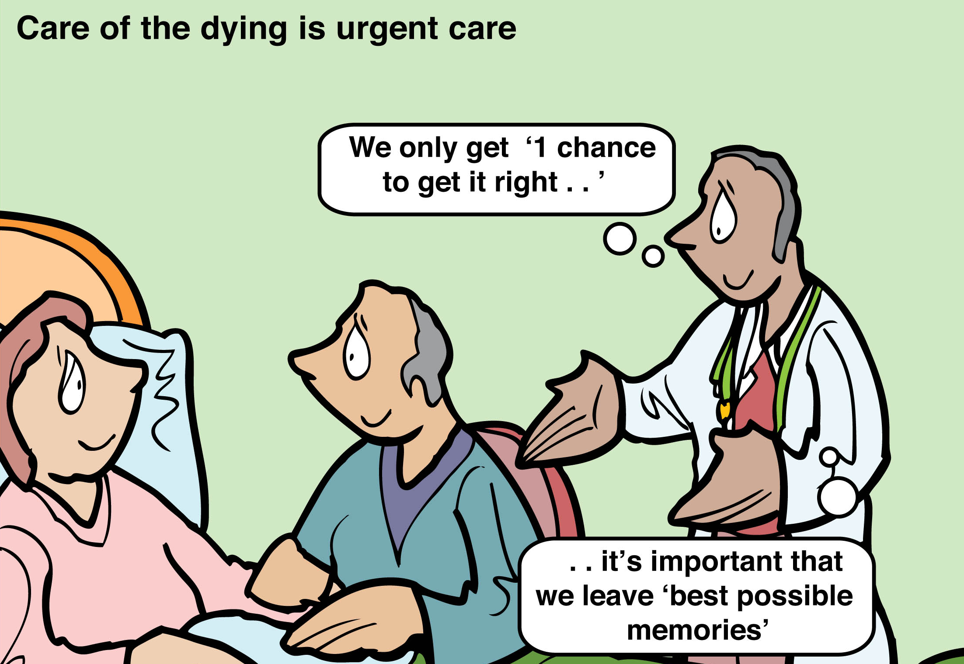
Thank you!!!

Slide 22
Special thanks!!
Amanda Lam
Dr. Sara Johnson
Palliative care student group

Slide 23
References
National Hospice and Palliative Care Organization: nhpco.org
WHO website
National Palliative care research center: npcrc.org
Pubmed
Center to advanced palliative care: capc.org
Cancer.gov
AAHPM.org
healthaffairs.org
beckershospitalreview.com
PMID: 21145468
American Academy of Hospice and Palliative Medicine Workforce Task Force
CDC.gov

